Slide 1
MANAGEMENT CONCEPTS
UNIT - IV Lesson – 11
Leadership

Slide 2
Meaning of leadership
Leadership is a process by which an executive can direct, guide and influence the behavior and work of others towards accomplishment of specific goals in a given situation.
Leadership is the ability of a manager to induce the subordinates to work with confidence and zeal.
Leadership is the potential to influence behaviour of others.

Slide 3
It is also defined as the capacity to influence a group towards the realization of a goal.
Leaders are required to develop future visions, and to motivate the organizational members to want to achieve the visions.
According to Keith Davis, “Leadership is the ability to persuade others to seek defined objectives enthusiastically. It is the human factor which binds a group together and motivates it towards goals.”
Koontz and O’Donnell, “Leadership is the ability of a manager to induce subordinates to work with confidence and zeal.”

Slide 4
1. Importance of Leadership
Leadership is an important function of management which helps to maximize efficiency and to achieve organizational goals.
The following points justify the importance of leadership in a concern.
Initiates action- Leader is a person who starts the work by communicating the policies and plans to the subordinates from where the work actually starts.

Slide 5
Motivation- A leader proves to be playing an incentive role in the concern’s working.
He motivates the employees with economic and non-economic rewards and thereby gets the work from the subordinates.
Providing guidance- A leader has to not only supervise but also play a guiding role for the subordinates.
Guidance here means instructing the subordinates the way they have to perform their work effectively and efficiently.

Slide 6
Creating confidence- Confidence is an important factor which can be achieved through expressing the work efforts to the subordinates, explaining them clearly their role and giving them guidelines to achieve the goals effectively.
It is also important to hear the employees with regards to their complaints and problems.

Slide 7
Building morale- Morale denotes willing co-operation of the employees towards their work and getting them into confidence and winning their trust.
A leader can be a morale booster by achieving full co-operation so that they perform with best of their abilities as they work to achieve goals.

Slide 8
Builds work environment- Management is getting things done from people.
An efficient work environment helps in sound and stable growth.
Therefore, human relations should be kept into mind by a leader.
He should have personal contacts with employees and should listen to their problems and solve them.
He should treat employees on humanitarian terms.

Slide 9
Co-ordination- Co-ordination can be achieved through reconciling personal interests with organizational goals.
This synchronization can be achieved through proper and effective co-ordination which should be primary motive of a leader.

Slide 10
Leadership styles
Great leaders are behind a success of great businesses.
There are various types of leadership styles that can help you lead your business and team members as well as to develop leaders yourself.
What are effective leadership styles?
To answer this question, let’s talk a little about what leadership really means because it is often confused with management.

Slide 11
While the two are related and leaders should be able to manage people, they are not one and the same.
Consider Dwight Eisenhower’s statement:
“Leadership is the art of getting someone else to do something you want done because he wants to do it, not because your position of power can compel him to do it”

Slide 12
Authoritarian/Autocratic leadership style
First, we have authoritarian, or autocratic leaders and as the name implies they focus on control and chain of command to achieve results.
While you don’t have to be a dictator to use this style, authoritarian leadership style certainly involves direct supervision, unwavering support of the message from leadership, and more one-sided feedback and communication than other styles.

Slide 13
Paternalistic leadership
It’s in the name with this one...paternalistic leadership is centred around treating subordinates as a parent would.
Advocates of this style would posit that treating their team as a family and focusing on maintaining personal relationships with them generates shared respect for one another, however, very much like in a real family, this respect is often based on loyalty and the need to feel part of a community rather than being earned.

Slide 14
Democratic/Participative leadership style
Democratic leader builds upon the notion that a leader isn’t someone who necessarily knows everything about everything, but is someone who is willing to listen to others, able to synthesise opinions and concede to popular opinion (within reason) when backed up by evidence.
Using democratic leadership style can lead to more group buy-in as members feel they have a voice, but only works when all employees have skills and knowledge that they are willing to share.

Slide 15
Laissez-faire leadership
Again, much like the political and economic behavioural science, laissez faire leaders can be described as leaders who allow their followers to do work and make decisions as they see fit, with little guidance or restraints from the leader.
Although at times we do have groups who are mostly self-sufficient, laissez-faire can border upon not being a leader at all, if we are not providing enough of a vision or incentive for team members to do their part.

Slide 16
1. Leadership and Subordinate Participation
The leadership continuum was originally written in 1958 by Tannenbaum and Schmidt and was later updated in the year 1973.
Their work suggests a continuum of possible leadership behavior available to a manager and along which many leadership styles may be placed.
The continuum presents a range of action related to the degree of authority used by the manager and to the area of freedom available to non-managers in arriving at decisions.

Slide 17
A broad range of leadership styles have been depicted on the continuum between two extremes of autocratic and free rein.
The left side shows a style where control is maintained by a manager and the right side shows the release of control.
However, neither extreme is absolute and authority and freedom are never without their limitations.

Slide 18
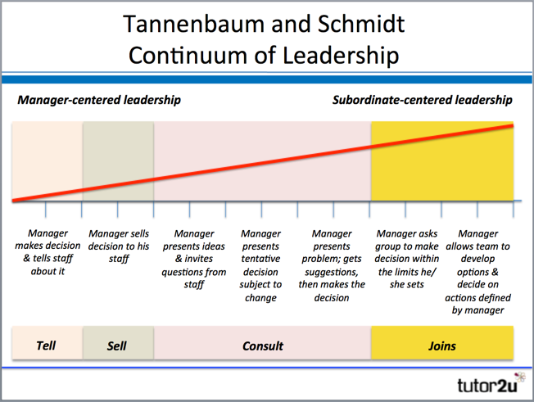

Slide 19
Tannenbaum and Schmidt devised their continuum that illustrates a range of potential leadership and management styles.
The Tannenbaum and Schmidt Continuum recognises that the chosen leadership style depends on a variety of factors, including the leader's personality, the perceived qualities of subordinates.
It also allows for "situational" factors such as the need for urgency in leadership and decision-making.

Slide 20
The continuum represents a range of action related to the:
– Degree of authority used by the leader or manager
– Area of freedom available to non-managers
Four main styles of leadership are identified in the Tannenbaum and Schmidt Continuum of Leadership:
TELLS
Leader identifies problems, makes decision and announces to subordinates; expects implementation

Slide 21
SELLS
Leader still makes decision, but attempts to overcome resistance through discussion & persuasion
CONSULTS
Leader identifies problem and presents it to the group. Listens to advice and suggestions before making a decision
JOINS
Leader defines the problem and passes on the solving & decision-making to the group (which manager is part of)

Slide 22
2. Managerial Grid
Developed by Robert Blake and Jane Mouton, this approach as shown in the following grid, has two dimensions −
Concern for people which includes such elements as provision of good working conditions, placement of responsibility on the basis of trust rather than concern for production.
Concern for production includes the attitudes of a supervisor toward a wide variety of things, such as quality of staff services, work efficiency, volume and quality of output, etc.

Slide 23
The bi-dimensional managerial grid identifies a range of management behavior based on the various ways that task-oriented and employee-oriented styles (each expressed as a continuum on a scale of 1 to 9) can interact with each other.

Slide 24
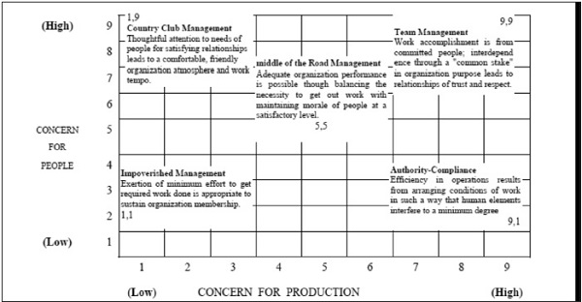

Slide 25
Management Style 1,1 −
Impoverished management with low concern for both people and production.
This is called laissez-faire management because the leader does not take a leadership role.
Also known as delegative leadership is a type of leadership style in which leaders are hands-off and allow group members to make the decisions.

Slide 26
Management Style 1,9 −
Country club management having high concern for employees but low concern for production.
These leaders predominantly use reward power to maintain discipline and to encourage the team to accomplish its goals.

Slide 27
Management Style 5,5 −
Middle of the road management with medium concern for production and for people.
Leaders who use this style settle for average performance and often believe that this is the most anyone can expect.

Slide 28
Management Style 9,1 −
Authoritarian management with high concern for production but low concern for employees exercising disciplinary pressure.
This approach may result in high production but low people satisfaction levels.

Slide 29
Management Style 9,9 −
Democratic management with high concern for both production, and employee morale and satisfaction.
The leader's high interest in the needs and feelings of employees affects productivity positively.
This theory concluded that style 9,9 is the most effective management style as this leadership approach will, in almost all situations, result in improved performance, low turnover and absenteeism, and high employee satisfaction.

Slide 30
3. Hersey and Blanchard’s Situational Leadership Model
As reaction to behavioural leadership approaches such as Blake and Mouton’s Managerial Grid, Hersey and Blanchard developed a theory (Hersey and Blanchard Situational Leadership Theory) that suggests that the most effective leadership style is affected by the circumstances leaders find themselves in.
They argue that a leader’s ability to lead depends upon certain situational factors.
By understanding, recognizing and adapting to these factors, leaders will be able to influence their surroundings and followers much more successfully than if these factors are ignored.

Slide 31
More specifically, Hersey and Blanchard focused a great part of their research on the characteristics of followers in determining appropriate leadership behaviours.
They found that leaders would have to modify their leadership style as their followers changed in terms of their ability (Task Readiness) and willingness (Psychological Readiness) to perform the required task.
A leader’s relationship with followers is therefore likely to go through different stages as these abilities and willingness can change over time.

Slide 32
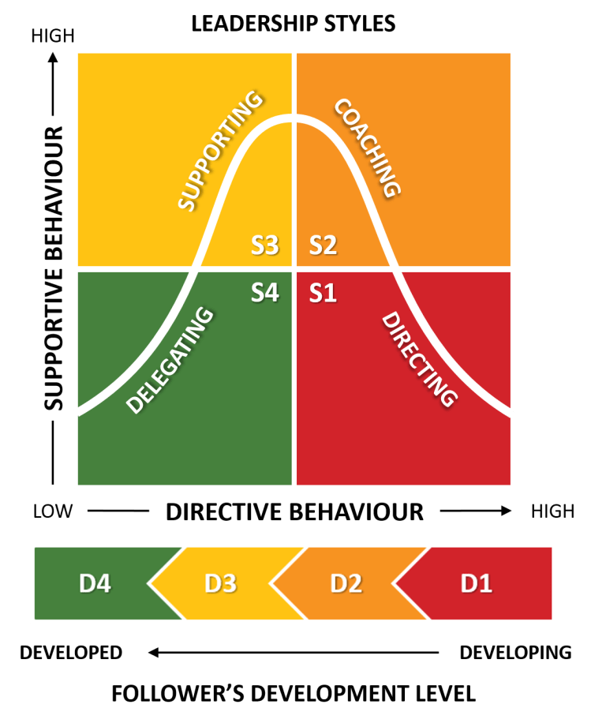

Slide 33
The four leadership styles (Telling, Selling, Participating and Delegating) Hersey and Blanchard came up with in order to better deal with these different stages of followers.
Leader’s Supportive Behaviour
A leader’s supportive behaviour reflects the ‘concern for people‘ dimension of Blake and Mouton’s Managerial Grid.
This means to what extent a leader puts emphasis on building and maintaining a good relationship with subordinates by paying attention to the security, well-being and personal needs of the employees.

Slide 34
The appropriate level of this relationship-focused approach is just like the directive behaviour determined by the readiness or development level of followers.
S1: Telling (Directing)
The S1 leadership style in the Hersey and Blanchard Situational Leadership Model puts a high emphasis on directive behaviour and a low emphasis on supportive behaviour.
A leader’s primary concern lays with the task delivery and less with the personal needs of the subordinates.

Slide 35
Typical behaviour for a S1 leadership style, according to Hersey, is offering step-by-step instructions, clear explanation of the consequences of non-performance and close supervision.
In such a situation, it is important that the task is clearly defined and the stages of the process are easy to follow.
This is important because the leader believes that the follower (R1) either does not know what to do or is unwilling and requires therefore a certain degree of coercive power.
Blanchard, on the other hand, believes that this style should be used for D1 followers who are highly ‘Enthousiastic Beginners‘.

Slide 36
They already have the motivation to do the tasks required, which lowers the need for supportive behaviour.
But they still lack the competence, which increases their need for directive behaviour.
S2: Selling (Coaching)
The next leadership style is the high directive and high supportive S2 leadership style.
Hersey argued that this style is needed for R2 followers who are willing, but not able to perform a task.

Slide 37
The leader’s style should therefore be concerned with increasing the confidence and skills of followers so that they can ultimately take on more responsibility for their actions.
Blanchard, however, believes this style is necessary for D2 followers, who used to be highly enthousiastic in the beginning but who lost confidence because their competences are failing them.
These ‘Disillusioned Learners‘ therefore need a leader with a higher concern for supportive behaviour that helps them gain confidence and become motivated again.

Slide 38
S3: Participating (Supporting)
The S3 leadership style applies to both R3 and D3 followers. This style (still) shows high supportive behaviours, but low directive behaviours.
This may involve listening, praise and a high level of interaction between leader and follower.
In addition, the leader puts a high level of trust in the follower to achieve the day-to-day tasks as the follower’s competence has also grown over time.
The leader will therefore only encourage and offer feedback when needed to motivate and develop the subordinate, but not as a comment on the task performance.

Slide 39
This is because the leader believes that the follower is capable enough of achieving the required tasks largely independently.
S4: Delegating
The final leadership style assumes a low supportive and a low directive behaviour and applies to R4 and D4 followers.
This is very much a ‘hands-off approach’ as the subordinate is perfectly able and willing to perform the tasks independently and with great responsibility.

Slide 40
The leader can further encourage autonomy, while keeping an eye on not overloading the follower with responsibility and not withdrawing completely from the follower’s proximity.
For these type of followers it is thus important as a leader to keep observing and monitoring them (albeit to a far lesser degree), in order to provide the necessary support if needed.

Slide 41
4. Path Goal Theory
The theory was developed by Robert House and has its roots in the expectancy theory of motivation.
The theory is based on the premise that an employee’s perception of expectancies between his effort and performance is greatly affected by a leader’s behavior.
The leaders help group members in attaining rewards by clarifying the paths to goals and removing obstacles to performance.
They do so by providing the information, support, and other resources which are required by employees to complete the task.

Slide 42
House’s theory advocates servant leadership.
As per servant leadership theory, leadership is not viewed as a position of power.
Rather, leaders act as coaches and facilitators to their subordinates.
According to House’s path-goal theory, a leader’s effectiveness depends on several employee and environmental contingent factors and certain leadership styles.

Slide 43
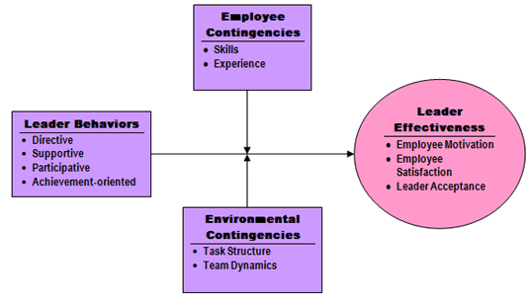

Slide 44
Leadership Styles
The four leadership styles are:
Directive: Here the leader provides guidelines, lets subordinates know what is expected of them, sets performance standards for them, and controls behavior when performance standards are not met.
He makes judicious use of rewards and disciplinary action.
The style is the same as task-oriented one.

Slide 45
Supportive: The leader is friendly towards subordinates and displays personal concern for their needs, welfare, and well-being.
This style is the same as people-oriented leadership.
Participative: The leader believes in group decision-making and shares information with subordinates.
He consults his subordinates on important decisions related to work, task goals, and paths to resolve goals.

Slide 46
Achievement-oriented: The leader sets challenging goals and encourages employees to reach their peak performance.
The leader believes that employees are responsible enough to accomplish challenging goals. This is the same as goal-setting theory.
According to the theory, these leadership styles are not mutually excusive and leaders are capable of selecting more than one kind of a style suited for a particular situation.

Slide 47
Contingencies
The theory states that each of these styles will be effective in some situations but not in others.
It further states that the relationship between a leader’s style and effectiveness is dependent on the following variables:
Employee characteristics: These include factors such as employees’ needs, locus of control, experience, perceived ability, satisfaction, willingness to leave the organization, and anxiety.

Slide 48
For example, if followers are high inability, a directive style of leadership may be unnecessary; instead a supportive approach may be preferable.
Characteristics of work environment: These include factors such as task structure and team dynamics that are outside the control of the employee.
For example, for employees performing simple and routine tasks, a supportive style is much effective than a directive one.
Similarly, the participative style works much better for non-routine tasks than routine ones.

Slide 49
When team cohesiveness is low, a supportive leadership style must be used whereas in a situation where performance-oriented team norms exist, a directive style or possibly an achievement-oriented style works better.
Leaders should apply directive style to counteract team norms that oppose the team’s formal objectives.

Slide 50
LEADERSHIP QUALITIES
Managerial Qualities According To Henry Fayol
Henry Fayol suggested the following the qualities that a manager should posses:
Physical.
Mental.
Moral.
Educational.
Technical.
Experience.

Slide 51
Dr. May Smith holds that a leader must have
intelligence,
good judgement capacity,
insight and imagination,
a sense of humour,
a sense of justice and
a well balanced personality.
According to Puckey, a leader should be made to coordinate and he should have the power to reflect the progress of the group.

Slide 52
The traits which Stogdill concluded to be important for leadership were
Intelligence,
Alertness,
Insight,
Responsibility,
Initiative,
Persistence,
Self-confidence and
Sociability.

Slide 53
Henry Mintzberg has categorised the leader’s skill as:
Figurehead. (a nominal leader or head without real power.)
Leader.
Liaison. (communication or cooperation which facilitates a close working relationship between people or organizations.)
Monitor.
Disseminator. (someone who spreads gossip or news to others. )

Slide 54
Spokesperson.
Entrepreneur.
Disturbance Handler.
Resource Allocator.
Negotiator.

Slide 55
Management systems and leadership
'Leadership is the person or group of people who directs and controls an organization at the highest level.
Top management has the power to delegate authority and provide resources within the organization.
Leadership is setting a new direction or vision for a group that they follow, ie: a leader is the spearhead for that new direction.

Slide 56
Management controls or directs people/resources in a group according to principles or values that have been established.
At Management Systems, we define effectiveness in the management (or leadership role) as the ability to successfully influence people on your team to achieve results in the most effective and efficient manner.

Slide 57
1. Management Systems of Organisation
System 1 – Exploitive-authoritative management.
System 2 – Benevolent-authoritative management.
System 3 – Consultative management.
System 4 – Participative management

Slide 58
2. Charismatic Leader
Charismatic authority is a concept of leadership developed by the German sociologist Max Weber.
It involves a type of organization or a type of leadership in which authority derives from the charisma of the leader.
The charismatic leadership style relies on the charm and persuasiveness of the leader.
Charismatic leaders are driven by their convictions and commitment to their cause.

Slide 59
Charismatic leaders also are sometimes called transformational leaders because they share multiple similarities.
Their main difference is focus and audience.
Charismatic leaders often try to make the status quo better, while transformational leaders focus on transforming organizations into the leader's vision.
Dr. Martin Luther King, Jr. was a charismatic leader who used powerful oratory, an engaging personality, and unwavering commitment to positive change in the lives of millions of people.

Slide 60
3. Reddin’s Three-Dimensional Model
The Three-Dimensional Grid or 3-D Leadership Model is developed by Professor Bill Reddin, who introduced the concept of “situational demands” which talks about the way in which the leader must behave to be most effective.
The 3-D model has taken into the consideration the beliefs of the managerial grid and added one more dimension to it i.e. Effectiveness.
The effectiveness means to know what was the result when one used a particular leadership style in a particular situation.

Slide 61
Thus, three-dimensional axes represent the “task-orientation”, “relationship orientation” and “effectiveness”.
Task orientation means the extent to which the superior directs his subordinate’s efforts towards the goal attainment.
The relationship orientation means the extent to which the manager has personal relations with his subordinates and finally, the effectiveness means the extent to which the manager is successful.

Slide 62
When the leadership style meets the demands of the situation, then the leadership is said to be effective else ineffective.
On the basis of this, there are four styles that a manager adopts and is shown in the figure below:

Slide 63
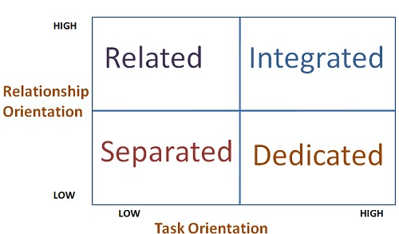

Slide 64
The Separated Manager is the one who is engaged in correcting deviations.
He is the person who formulates the rules and policies and imposes these on others.
The Related Manager is the one who likes to work with others and see an organization as a social system where everyone works together.
He does not worry about the time and accepts others as they are and do not try to change them.

Slide 65
The Dedicated Manager is the one who is task oriented and is only concerned with the production.
He does not like to mix up with the subordinates and cannot work without power and responsibility.
The Integrated Manager is the one who mixes up with the subordinates and facilitate two way communication.
His major emphasis is on building a strong teamwork and effective communication network.

Slide 66
Effective Styles
Executive
Developer
Benevolent autocrat
Bureaucrat
Ineffective Styles
Compromiser
Missionary
Autocrat
Deserter

Slide 67
Integrating leadership styles
Bill Reddin was a British professor and management behaviouralist, who - during his time at MIT, the University of New Brunswick, and as an independent consultant - developed some key theories relating to situational leadership styles and the managerial impact on organisational effectiveness.
The culmination of his action-oriented work was his 3D Model of Leadership, first outlined in his 1983 thesis Managerial Effectiveness and Style:

Slide 68
Individual or Situation, which identified several different leadership styles and their effectiveness in any number of typical situations.
The most important concept within his work was that there is no single most effective leadership style, considering the numerous and varied situations a leader will find themselves in.

Slide 69
The 3D Leadership Model
The four basic leadership styles as identified by Reddin were:
Related - A related leader enjoys team-based, cooperative working.
They do not focus on directing or dictating orders to staff, and allow much more freedom and responsibility.
Integrated - An integrated manager retains the cooperative nature of the group, and encourages two-way communication.
They emphasise the effectiveness of this communication and building a strong team capable of completing tasks to the best of their potential.

Slide 70
Dedicated - A dedicated manager is only truly concerned with the end result of the task and focuses on improving the production process.
They retain power and responsibility with themselves, allowing them to dictate roles and requirements to others.
Separated - A separated manager focuses on correcting deviations from the norm.
They formulate policies and rules and impose them on others but do not take a direct, commanding role on themselves.

Slide 71
Each of these leadership styles is separated by its position along two major axes:
Task Orientation
Relationship Orientation.
This refers to the proportion of concern that the leader in question has for either the results of the task, or for the needs and development of the individuals involved.
The central matrix in the diagram below represents Reddin's initial model, showing the four major leadership styles and their positions along the Task-Relationship axis.

Slide 72
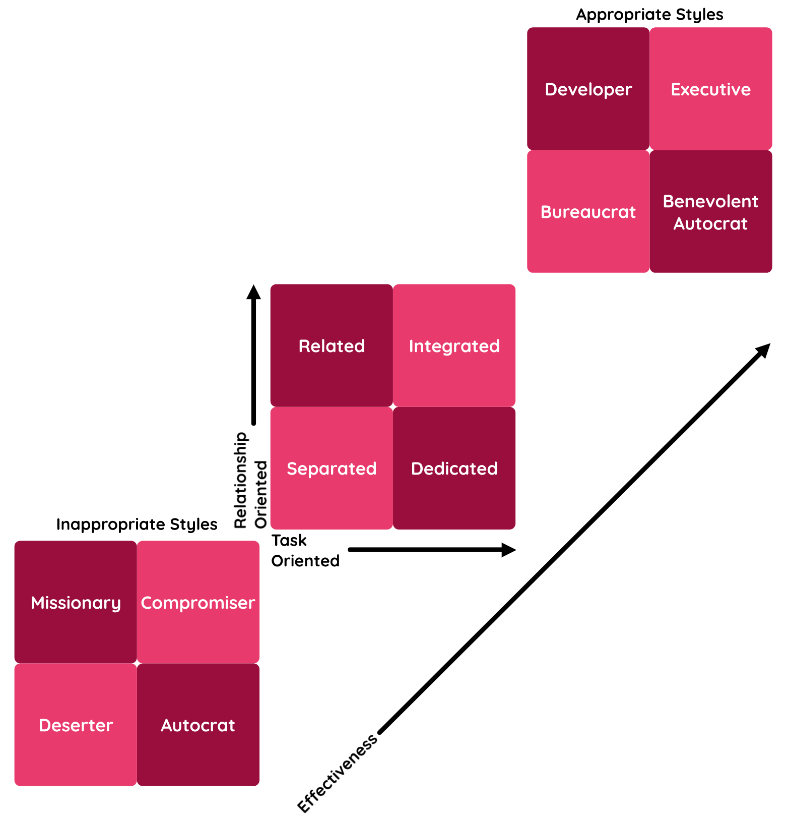

Slide 73
Reddin later expanded on his initial theory, adding in the third dimension of Effectiveness.
This effectiveness was defined by the appropriateness of the particular leadership style in any given situation and he argued that this should be the main focus of any manager's efforts.
As you can see in the diagram, the appropriate versions of the initial styles can be seen in the upper-right (Developer, Executive, Benevolent Autocrat, Bureaucrat) and the inappropriate styles (Missionary, Compromiser, Autocrat, Deserter) in the bottom-left.

Slide 74
These are not new styles in themselves, only the primary styles when applied to appropriate or inappropriate situations.
"Any managerial style has a situation appropriate to it, and many situations inappropriate to it…" - William Reddin
The true strength of a leader or manager is to know when to utilise each of the basic leadership styles, and how to apply them to appropriate situations.
Also discussed were two other key concepts:
Flexibility
Rigidity

Slide 75
These refer to how malleable the individual's style was in various scenarios.
The primary styles are fairly broad and all-encompassing, and also highlighted that leadership style could not necessarily be identified purely by examining the effectiveness of the situation.
Choosing the Most Appropriate Leadership Style
The most difficult part of applying Reddin's theory is for managers to understand when to employ each of the different styles.

Slide 76
In general, this is something which can only be understood through experience, and close examination of the situation.
A manager with a strong awareness of the requirements of tasks and demands of a situation will be capable of interpreting the necessity of greater task orientation or greater people orientation:
Task-orientated approaches generally are most effective in scenarios when the group is constrained by resources or time, when there is disorganisation which needs to be brought back into an order or when the leader is working with inexperienced or low-skilled team members.

Slide 77
People-oriented approaches are often more effective in more open, creative tasks, when the leader sees the opportunity to develop their staff's leadership and skills over the long term or to motivate them through new experiences and greater responsibility.
The leader may also see fit to work on a more people-centric basis in times when they have a highly experienced, skilled and competent team.

Slide 78
Leaders, as people, will likely have a natural predisposition towards certain approaches to the task.
However, it is still possible to understand that sometimes it is beneficial to be more flexible in their approach, allowing them to maximise the rewards of the situation at hand.

Slide 79
The appropriate versions of the initial styles can be seen in the upper-right
Developer,
Executive,
Benevolent Autocrat,
Bureaucrat
and the inappropriate styles
Missionary,
Compromiser,
Autocrat,
Deserter
in the bottom-left.

Slide 80
1. Measuring Leadership Style
The Fiedler Contingency Model was created in the mid-1960s by Fred Fiedler, a scientist who studied the personality and characteristics of leaders.
The model states that there is no one best style of leadership.
Instead, a leader's effectiveness is based on the situation.
This is the result of two factors – "leadership style" and "situational favorableness" (later called "situational control").

Slide 81
Leadership Style
Identifying leadership style is the first step in using the model.
Fiedler believed that leadership style is fixed, and it can be measured using a scale he developed called Least-Preferred Co-Worker (LPC) Scale .
The scale asks you to think about the person who you've least enjoyed working with.
This can be a person who you've worked with in your job, or in education or training.
You then rate how you feel about this person for each factor, and add up your scores.

Slide 82
If your total score is high, you're likely to be a relationship-orientated leader.
If your total score is low, you're more likely to be task-orientated leader.

Slide 83
Figure 1: Least-Preferred Co-Worker Scale
Unfriendly 1 2 3 4 5 6 7 8 Friendly
Unpleasant 1 2 3 4 5 6 7 8 Pleasant
Rejecting 1 2 3 4 5 6 7 8 Accepting
Tense 1 2 3 4 5 6 7 8 Relaxed
Cold 1 2 3 4 5 6 7 8 Warm
Boring 1 2 3 4 5 6 7 8 Interesting
Backbiting 1 2 3 4 5 6 7 8 Loyal
Uncooperative 1 2 3 4 5 6 7 8 Cooperative
Hostile 1 2 3 4 5 6 7 8 Supportive
Guarded 1 2 3 4 5 6 7 8 Open
Insincere 1 2 3 4 5 6 7 8 Sincere
Unkind 1 2 3 4 5 6 7 8 Kind
Inconsiderate 1 2 3 4 5 6 7 8 Considerate
Untrustworthy 1 2 3 4 5 6 7 8 Trustworthy
Gloomy 1 2 3 4 5 6 7 8 Cheerful
Quarrelsome 1 2 3 4 5 6 7 8 Harmonious
Tables from "A Theory of Leadership Effectiveness" by Professor F.E. Fiedler. © 1967. Reproduced with permission from Professor F.E. Fiedler.

Slide 84
The model says that task-oriented leaders usually view their LPCs more negatively, resulting in a lower score.
Fiedler called these low LPC-leaders. He said that low LPCs are very effective at completing tasks.
They're quick to organize a group to get tasks and projects done.
Relationship-building is a low priority.
However, relationship-oriented leaders usually view their LPCs more positively, giving them a higher score. These are high-LPC leaders.

Slide 85
High LPCs focus more on personal connections, and they're good at avoiding and managing conflict.
They're better able to make complex decisions.
Situational Favorableness
Next, you determine the "situational favorableness" of your particular situation. This depends on three distinct factors:

Slide 86
Leader-Member Relations – This is the level of trust and confidence that your team has in you.
A leader who is more trusted and has more influence within the group is in a more favorable situation than a leader who is not trusted.
Task Structure – This refers to the type of task you're doing: clear and structured, or vague and unstructured.
Unstructured tasks, or tasks where the team and leader have little knowledge of how to achieve them, are viewed unfavorably.

Slide 87
Leader's Position Power – This is the amount of power you have to direct the group, and provide reward or punishment.
The more power you have, the more favorable your situation.
Fiedler identifies power as being either strong or weak.

Slide 88
2. Leader Gets what He Gives
Amitai Etzioni, in exploring sources of organizational power, offered a synthesis of systems that organizations adopt to secure member compliance.
His interest was the manner in which people in organizations conform to organizational requirements and follow the standards of behavior expected.
Goal-oriented, performance directed organizations require the compliance of members: the problem is that deviance from these standards occurs because of weaknesses in member commitment.

Slide 89
Thus, systems of power are exerted by other members of the organization – both by managers and other members. Compliance is ensured by organizational control and authority structures, formal hierarchies of authority, supervision, job definitions, policies and specified procedures.
These make the organization less dependent on individual variability and whim.
There is a motivation element to this also, as these structures shape the involvement of the individual within the organization he belongs to.

Slide 90
The simple proposition is that the greater the individual’s level of commitment, the less formal control is needed .
Etzioni’s classification scheme includes coercive, utilitarian and normative systems. One can label organizations or parts of organizations as one sees them adopting such systems.
The coercive system reflects the organization’s ability to apply physical, constraining force and pain for non-compliance.
Examples might include prisons or other control systems that enable the withdrawal of member freedoms and privileges.

Slide 91
The involvement with the organization stemming from coercive systems of control is likely to be alienated and at best passive with negative feelings and disassociation.
Examples of coercive power in organizations include the implied or real ability to fire, demote or transfer to undesirable positions.
Etzioni points out that coercive methods tend to nurture dysfunctional group processes, such as: dislike and rejection, anger and conflict, conspiracies and coalitions, and reduced intrinsic motivation (Etzioni 1961, 127).

Slide 92
Utilitarian systems offer various kinds of material or non-material rewards to secure member compliance.
Membership is based on the member contracting with the organization and bargaining over the desired reward in return for compliance, loyalty, reliability and overall performance.
In this system, members consider “what’s in it for them” (i.e., overtime, a pay raise, a promotion, a steady income, a long-term future).

Slide 93
In short, the utilitarian system is power based on a system of rewards or punishments.
Businesses, which use pay raises, promotions, or threats of dismissal, are essentially utilitarian organizations.
Systems that use normative power have a system of control that is dependent upon shared values which are promoted and which members subscribe to.
The organization consciously generates and maintains these values, all of which are represented in various signs and symbols that may be visual, verbal, behavioral and conceptual, or any combination of the four.

Slide 94
Commitment to the organization’s ideology brings with it persuasive and suggestive power.
Members internalize organizational values.
Individuals within the organization act as one, with an intensive commitment to the organization and its goals.
Etzioni’s systems are evident in most organizations.

Slide 95
Thank you

